Slide 1
Superficial Cancer of the Esophagus and GE Junction

Slide 2

Anatomy
Food moves from the throat
$→$ esophagus
$→$ stomach
$→$ small bowel (jejunum)

Slide 3
Types of Esophageal Cancer
There are two common types of esophageal cancer
Adenocarcinoma
Squamous Cell Carcinoma
In many ways, these to different types of esophageal cancer behave the same.

Slide 4
Cancer Staging
Staging refers to the tests to determine
How large is the tumor?
Has there been spread to lymph nodes?
Has it spread to other parts of the body?
Treatment options depend upon the cancer stage

Slide 5
Cancer Staging
T = Tumor - Depth of growth into the wall
N = Nodes - Spread to the lymph nodes
M = Metastasis - Spread to liver, lungs, or bone

Slide 6
Early Stage Cancers
Cancers start on the very inside layer called the mucosa

Slide 7
Locally-advanced Cancers
Over time, cancers can grow into the muscular wall

Slide 8
Lymph Nodes
In some cases, cancer cells can break off from the main tumor and spread to lymph nodes

Slide 9

T Stage
Cancers are categorized based upon the thickness of the tumor, known as the T stage

Slide 10

N Stage
Cancers are categorized by whether there is spread to the nodes.
N0 cancers have not spread to the nodes
N1 cancers have spread to the nodes.

Slide 11

M Stage
Some cancers spread to other parts of the body
M0 cancers have not spread to other parts of the body
M1 cancers have spread lungs, liver, or bone

Slide 12

PET scan
Similar to CT scan
Tracer shows ‘hot spots’
Cancer
Inflammation or infection
Normal organs (heart, kidneys)

Slide 13

Endoscopic Ultrasound
Similar to upper endoscopy (EGD)
Ultrasound in scope
Evaluates T stage

Slide 14

Laparoscopy
Some stomach cancers can spread inside the abdomen
Areas of spread can be very small (grain of rice)
Laparoscopy can detect spread inside the abdomen

Slide 15
Laparoscopy
General anesthetic
Several 1/4” incisions
Telescope examines the abdomen
Biopsies can be performed.

Slide 16

Gastroesophageal Reflux
A one-way valve normally keeps acid within the stomach and prevents it from entering the esophagus

Slide 17
Gastroesophageal Reflux
A one-way valve normally keeps acid within the stomach
If the valve does not work properly, acid enters the esophagus and cause heartburn and damage to the lining of the esophagus.

Slide 18

Barrett’s Espohagus
Over time, the lining of the esophagus undergoes change in response to the acid.

Slide 19
Dysplasia
Over a period of years, pre-cancerous changes can develop within Barrett’s esopahgus.
These changes can be seen by the pathologist from biopsies taken from the esophagus
Over time, low-grade dysplasia can progress to high-grade dysplasia

Slide 20
Dysplasia $→$ Cancer
Low grade dysplasia: Risk of cancer 0.5% per year
High-grade dysplasia: Risk of cancer 5% per year
$⇒$ Surveillance with upper endoscopy is critical

Slide 21
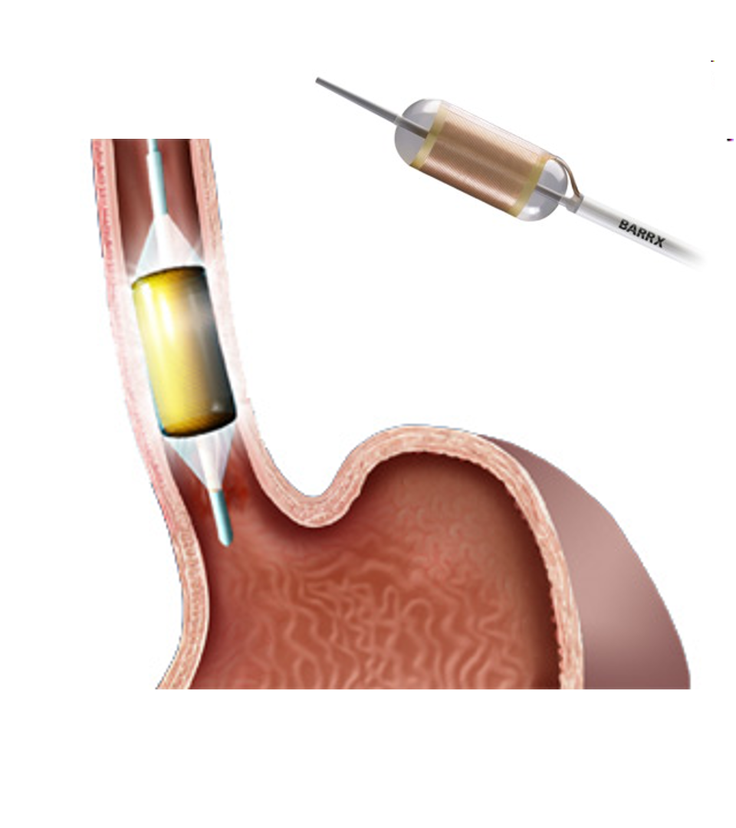
Radiofrequency ablation for Dysplasia
Dysplasia can be treated with destroying the mucosa, the inner layer of esophgus
Ablation of the mucosa with microwave energy
Circular balloon with an antenna used to ablate the mucosa

Slide 22
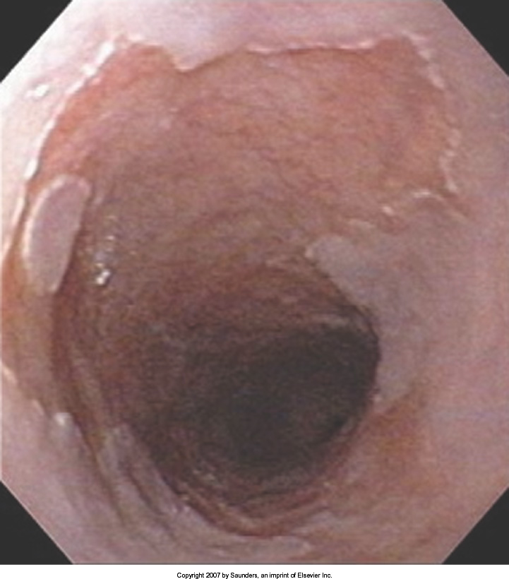
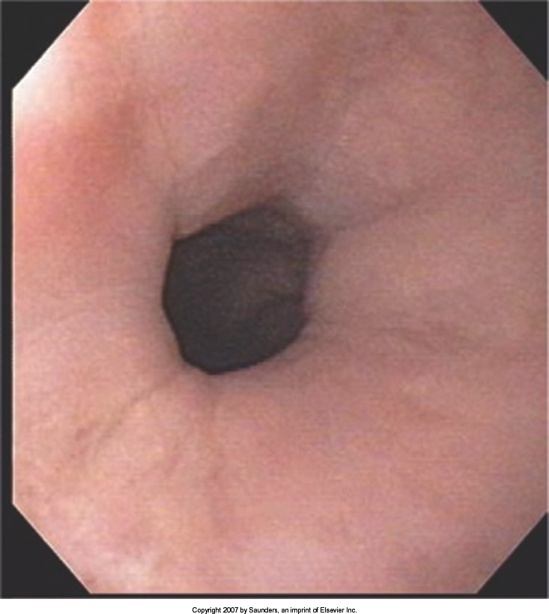
Radiofrequency ablation for Dysplasia
Before Ablation
After Ablation

Slide 23
Treatment Plan
Superficial (T1)
Endoscopic Therapy
Localized (T1b/T2)
Surgery (esophagectomy)
Locally-advanced (T3M0)
Chemo$±$Radiation $→$Surgery
Metastatic (M1)
Chemotherapy

Slide 24
Superficial Cancers
Superficial Cancer: T1a N0
Treatment is often with endoscopy without the need for surgery.

Slide 25
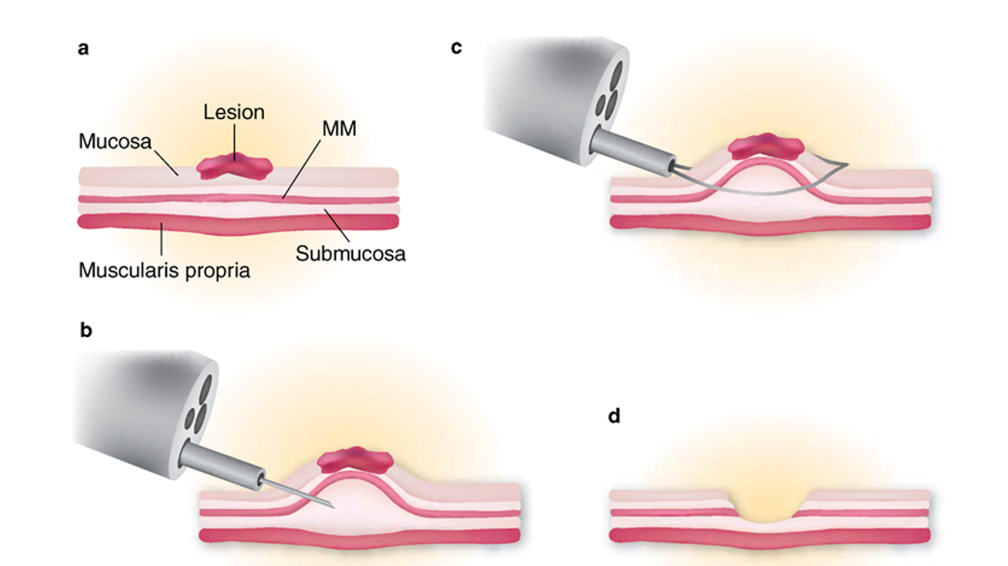
Endoscopic Mucosal Resection (EMR)
Endoscopic procedure to remove a superficial tumor from the inner layer of the esophagus

Slide 26

Endoscopic Mucosal Resection - Favorable
Clear margins at the edge AND
Clear deep margin AND
Tumor appears slow-growing under microscope

Slide 27

Endoscopic Mucosal Resection - Favorable
Clear margins at the edge AND
Clear deep margin AND
Tumor is slow-growing under microscope

Slide 28
Endoscopic Mucosal Resection - Favorable
EMR may be the only treatment required
Requires endoscopic surveillance

Slide 29

Endoscopic Mucosal Resection - Unfavorable
Tumor at edge margin OR
Tumor at deep margin OR
Tumor rapidly-growing under microscope

Slide 30

Endoscopic Mucosal Resection - Unfavorable
Tumor at edge margin OR
Tumor at deep margin OR
Tumor rapidly-growing under microscope

Slide 31
Endoscopic Mucosal Resection - Unfavorable
Esophagectomy (surgery) is standard recommendation

Slide 32
Surgery for Esophageal Cancer
Surgery for esophageal cancer is performed for:
Superficial Tumors (T1) not removed by endoscopy
Localized Tumors (T2 N0 M0)
Locally Advanced (T3 M0) after preop therapy

Slide 33

Goals of Surgery
Remove tumor from esophagus
Remove surrounding lymph nodes
Create a new esophagus

Slide 34

Ivor Lewis (Transthoracic) Esophagectomy
Removes tumor and lower 1/3 esophagus
Removes surrounding lymph nodes
GI tract reconstructed

Slide 35

Reconstruction
New esophagus is created from the stomach in the abdomen by fashioning it into a tube.

Slide 36

Ivor Lewis esophagectomy
The new esophagus is now brought up into the chest. A connection is made between the esophagus and the stomach, called an anastomosis.

Slide 37

Minimally-invasive Ivor Lewis
Small incisions abdomen and chest
Surgical telescope and instruments
Smaller incisions $→$ faster recovery and less discomfort

Slide 38

Open Ivor Lewis
Mininally-invasive approach feasible in 95% of cases
In some cases, an open approach is still necessary.

Slide 39

Total Esophagectomy
For patients with tumors in the upper esophagus, we need to remove more of the esophagus
We need to remove the whole esophagus, including the portion in the neck

Slide 40


McKeown Esophagectomy

Slide 41

Colon Interposition
If the stomach is not suitable to make a new esophagus, the colon can be used to replace the esophagus

Slide 42

Colon Interposition

Slide 43
Risks of Esophagectomy
Esophagectomy is a complex operation, with a real risk of complications.
Two significant complications:
Anastomotic leak
Pneumonia

Slide 44
Anastomotic Leak
The anastomosis is surgical connection between the esophagus and the stomach.

Slide 45

Anastomotic Leak
If healing doesn’t occur:
Leakage of fluid from the esophagus
Infection in the space between the lungs
Requires additional time in the hospital

Slide 46
Anastomotic Leak
If leak occurs:
Some leaks will seal
Stent may be required to help healing
Occasionally additional surgey is required

Slide 47
Anastomotic Leak
Risk of leak depends on:
Type of operation performed
Nutritional status of patient
Experience of the surgeon

Slide 48

Pneumonia
Occurs in 10-15% of patients after esophagectomy.
Requires treatment with antibiotics
Requires a longer hospitalization.

Slide 49
Preventing Pneumonia
Several ways to help prevent pneumonia:
Deep breathing
Coughing
Walking
After surgery, this means:
Sitting in a chair most of the day
Walking in the halls as soon as possible

Slide 50


Minimally-invasive Esophagectomy

Slide 51
Risks of Surgery
Risks related to anesthesia
Heart attack (5%)
Irregular heart rhythm (15%)
Pneumonia (10%)
Blood clots in legs (<5%)
Pulmonary embolism (2%)

Slide 52
Risks of Surgery
Risks related to Surgery
Anastomotic leak (5%)
Stricture at anastomosis (15%)
Death within 90 days of surgery
Low risk patients = 2%
Intermediate risk = 10%
High risk = 30%

Slide 53
Risks of Surgery
 | Age <75 | Age >75
Normal Muscle (75%) | 2% | 10%
Low Muscle (25%) | 10% | 30%
Risks of Death within 90 Days of Surgery

Slide 54
Day Prior to Surgery
Clear liquids for 24 hours prior to surgery
Check with Pre-op nurse regarding medicines day prior to surgery
No tube feedings the night before surgery

Slide 55
Day of Surgery
Arrive at 5am – nothing to eat or drink after midnight.
Medicines OK w/ a sip of water
sip of black coffee but no cream.
Surgery will be cancelled if you have cream/milk
Waiting room for family and friends on 5th floor

Slide 56
Epidural Catheter for Pain Control
Remains in place for 2-5 days
Dosage can be adjusted as needed
Can make it more difficult to urinate
May require foley catheter in bladder
Foley catheter removed after epidural removed

Slide 57
Intensive Care Unit (ICU) (2-4 days)
Surgical ICU on 11th floor
NG tube in nose to drain stomach and esophagus
Catheter in bladder
Chest tube right chest
Abdominal drains (usually 2)
Feeding jejunostomy (usually stays in 8 wks)

Slide 58
Intensive Care Unit (ICU)
Bladder catheter removed → check that bladder empties properly
Chest tube removed (day 2-4) → follow-up x-ray
Fluid emptied from drains every few hours
Start tube feedings by feeding
Feeding jejunostomy (stays in 8 weeks)

Slide 59
Ward - 6Tower
Jejunostomy feeds started
Up in a chair most of the day
Walking in the halls
Start with assistance
Improves lung function
Prevents loss of muscle strength

Slide 60
Jejunostomy Feeds
Jejunostomy tube feeds
Start continuous (24 hours)
Convert to night-time only (16 hours)
Water administered through feeding tube
Usually 8oz 4 times/day
Important to prevent dehydration

Slide 61

Jejunostomy Tube
Nutrition to bypasses the esophagus and stomach
Placed in small intestine
Pump administers feedings slowly
Feeding done at night

Slide 62
Jejunostomy Typical Regimen
Jejunostomy tube feeds for 16 hours (6pm-10am)
Men: 75mL/hour x 16 hours = 5 cartons
Women: 60mL/hour x 16 hours = 4 cartons
Water 240ml (8oz) via syringe 4x/day
Hospital nurses will teach use of the feeding tube

Slide 63
Jejunostomy Feeds with Diabetes
Jejunostomy feedings elevate blood sugars
Insulin may be required along with feeds
Typical Pattern for tube feeds
Feeds run via pump from 6pm to 10am
Insulin at 6pm (70/30 insulin)
Insulin at Midnight (70/30 insulin)
No insulin if tube feedings are not run

Slide 64

Jejunostomy Video
A video is available to help become familiar with the feeding jejunostomy

Slide 65
Activity after Surgery
Up in chair most of the day
Walking with help from nurse/Physical Therapist
Goals:
Improve lung function
Prevent muscle loss

Slide 66
Nasogastric (NG) Tube
Tube passed through nose into stomach
Drains fluid from stomach
Prevents vomiting
Upper GI X-ray on 2nd or 3rd day after surgery
If stomach empties well $→$ NG tube removed
Otherwise, X-ray repeated 2-3 days later

Slide 67
Swallowing Evaluation
Once NG tube has been removed:
Modified barium swallow in radiology
Drink a white chalky liquid (barium)
Look for proper swallowing function
70% of patients $⇒$ liquids started by mouth

Slide 68
Oral Intake at Home
Most are taking protein shakes when they go home
Protein shakes are started after tolerating water
2 oz per hour to start
4 oz per hour if 2oz are tolerated well

Slide 69
Discharge
Goal: ready to leave day #6/7 after surgery
Night-time tube feedings (6pm to 10am)
Nutrition by mouth (70% of patients)
1 oz of water per hour by mouth OR
Protein shakes 4oz every 2 hours
Water through tube 8oz four times per day
Home care nursing (feeding tube teaching)
Home infusion (tube feeding supplies)

Slide 70
Nutrition after Surgery
At discharge home:
Protein shakes 4oz every 2 hrs
Tube feeds 4-5 cans at night (6pm-10am)
10-12 Days: Increase protein shakes
Tube feeds 3-4 cans at night
Three weeks: Post-esophagectomy Diet
8-12 weeks: Remove feeding tube (in office)

Slide 71
Transition from Tube Feeds $→$ Eating
Dietitian will calculate daily protein goal
Typically 60-75 grams protein/day
Each carton of tube feeding has 15 grams
75 grams protein = 5 cartons/night
More intake by mouth $→$ tube feeds reduced
Spread out protein during the day (20gm/meal)
Three meals + 2-3 high-protein snacks

Slide 72
Post-esophagectomy Diet
Soft Consistency
High Protein
Avoid sugary liquids (can cause ‘dumping’)
Avoid raw vegetables (and salads)
Eating
Small, frequent meals
Sit up for 30-45 minutes after eating
Avoid eating within 2 hours of bedtime

Slide 73
Medicines at Home - Pain
Acetaminophen (Tylenol) 1000mg 4x/day
Gabapentin 300mg 3 times/day
Oxycodone
As needed in addition to Tylenol/gabapentin
Will begin reducing dose at first postop visit
Can usually discontinue by 4 weeks
NO DRIVING WHILE ON OXYCODONE

Slide 74
Non-steroidals Anti Inflammatory (NSAID)
Non-steroidal anti-inflammatories (Celebrex)
200 mg every 12 hours starting at 2 weeks
NO GOODY POWDERS OR BCs
(Can cause permanent scarring at the surgery site)

Slide 75
Acid Blockers = Proton Pump Inhibitors
Examples include ompeprazole and pantoprazole
Will stay on for at 1-2 years to prevent acid reflux
Important in preventing scarring at anastomosis (new connection between esophagus and stomach)
To administer through feeding tube, open capsule and resuspend beads in 60mL (2oz) of water

Slide 76
Medicines at Home
Reglan – Helps stomach empty
Will plan to stop after six weeks
0.1% risk of tardive dyskinesia (nervous tic)
Remeron – Helps improve appetite
Can cause vivid dreams
Used for several weeks after surgery
Will stop within first three months of surgery

Slide 77
Metoprolol = Beta Blockers
Slows heart rate and lowers blood pressure
Used to prevent rapid heart rate
Patients not taking a beta blocker prior to surgery $→$ wean after after surgery
Patients taking a beta blockerprior to surgery $→$ return to prior dose and drug after surgery

Slide 78

Sleeping at Home
Reflux can occur the first few weeks/months after surgery
This improves over the first few months
A wedge pillow can be helpful for sleep

Slide 79
Postoperative Visit at 7-10 Days
Check surgical site
Remove staples (if needed)
Adjust medicines as needed
Insulin (for diabetic patients on insulin)
Reduce beta blocker medicines
Advance diet
Reduce tube feeds

Slide 80
After surgery
Wean off medicines added after surgery
Pain medicines
Beta-blockers
Reglan and Remeron
Continue acid blockers for at least 1 year

Slide 81
Jejunostomy Removal
Jejunostomy tube is removed in the office once you can take in enough nutrients by mouth
Removal usually around 8 weeks after surgery
May take 30 minutes and some local anesthetic to loosen up the tube for removal.

Slide 82
Nutritional Monitoring after Surgery
You may have difficulty absorbing some nutrients:
Iron
Vitamin B12
Vitamin D

Slide 83
Nutritional Monitoring after Surgery
About 3 months after the jejunostomy tube is removed, we will check blood levels:
Iron (ferritin)
Vitamin B12
Vitamin D

Slide 84
Nutritional Replacements after Surgery
Vitamin or iron replacements can be ordered by:
Primary Care Provider (PCP)
Medical Oncologist
Surgeon
If levels are low
Replacement
Repeat testing in 3-6 months

Slide 85
Team Members - Physicians
Primary Care Provider
Gastroenterologist
Medical Oncologist (chemotherapy)
Radiation Oncologist (radiation)
Surgeons
Jonathan Salo
Jeffrey Hagen
Michael Roach

Slide 86
Team Members - Support Staff
Dietitian - Liz Koch
Nurses - Brandon Galloway - Kit Sluder - Sarah Ezell - Rebecca Wicks
Navigator - Laura Swift

